Slide 1
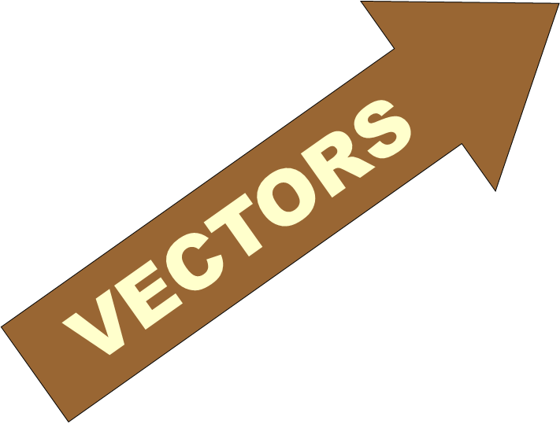
FİZ 137
CHAPTER 3 - VECTORS
Dr. Şeyda ÇOLAK
2018 - 2019

Slide 2
In this chapter we learn the basic mathematical language to describe vectors.
In particular we will learn the followings:
- Geometric vector addition and subtraction - Resolving a vector into its components - The notion of a unit vector - Add and subtract vectors by components - Multiplication of a vector by a scalar - The scalar (dot) product of two vectors - The vector (cross) product of two vectors

Slide 3
Scalar and Vector Notation
• In Physics we have parameters that can be completely described by a number and are known as “scalars” .
Eg. Temperature and mass are such parameters.
• Other physical parameters require additional information about direction and are known as “vectors”.
Eg. Displacement, velocity and acceleration are such parameters.

Slide 4
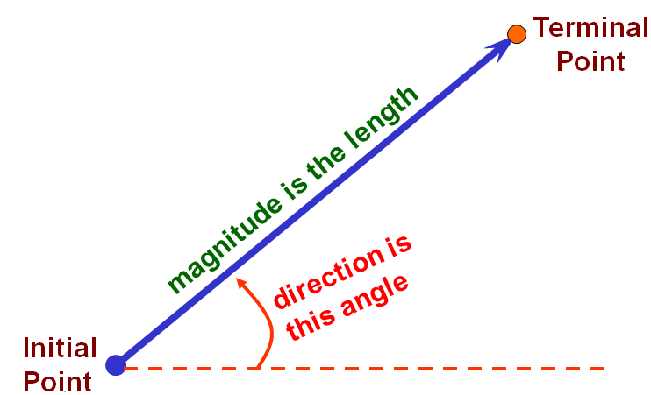
VECTORS

Slide 5
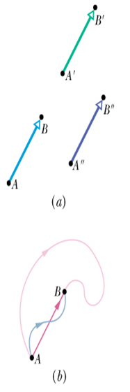

An example of a vector is the displacement vector which describes the change in position of an object as it moves from point A to point B. This is represented by an arrow that points from point A to point B. The length of the arrow is proportional to the displacement magnitude. The direction of the arrow indicated the displacement direction.
The three arrows from A to B, from A' to B', and from A'' to B'', have the same magnitude and direction. Result: A vector can be shifted without changing its value if its length and direction are not changed.
Vectors are written in two ways: Method 1: (using an arrow above)
Method 2: a (using bold face print)
Magnitude of the vector is indicated by italic print: a

Slide 6
Geometric Vector Calculation

Slide 7
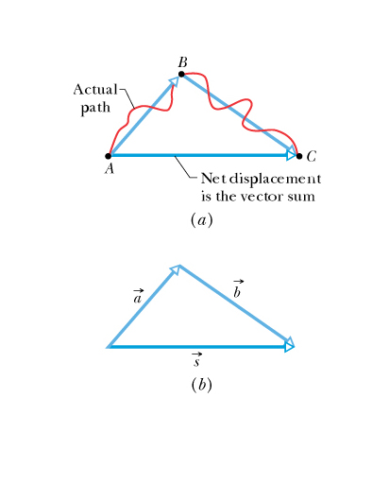
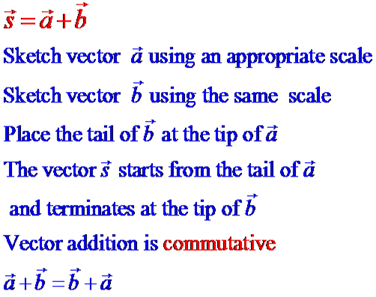
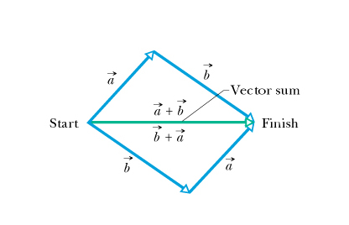
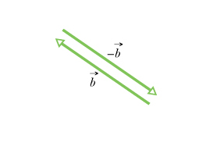
Geometric Vector Addition

Slide 8
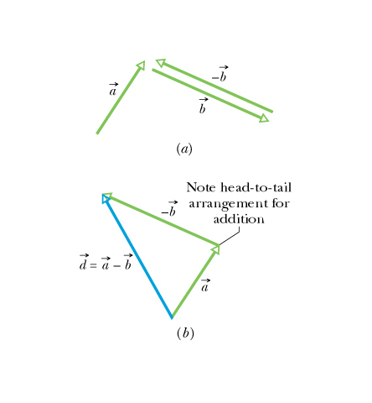
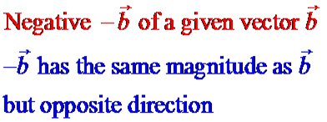
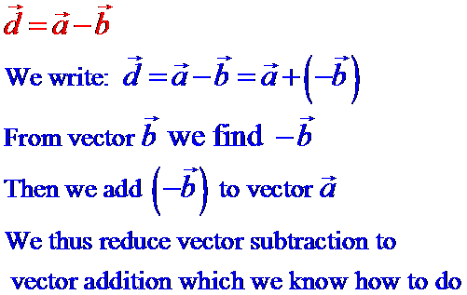
Geometric Vector Subtraction

Slide 9
VECTOR CALCULATION BY
THE METHOD OF COMPONENTS
We can ALSO add and subtract vectors by using the method of components.
For many applications this is a more convenient method.

Slide 10
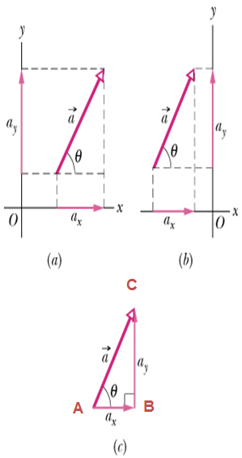
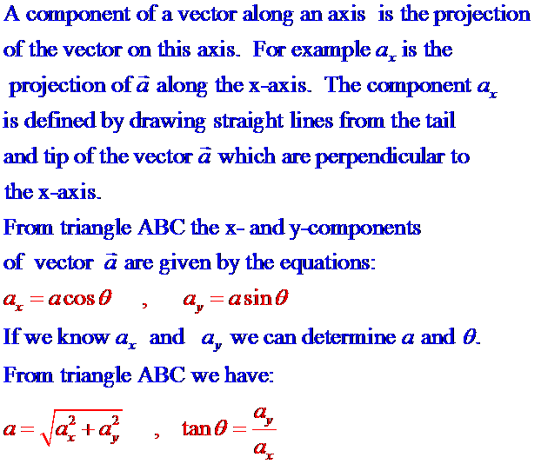

Slide 11
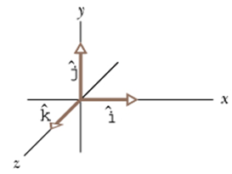
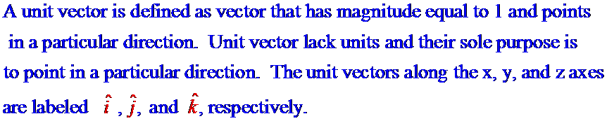
Unit Vectors

Slide 12
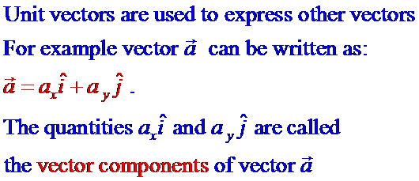
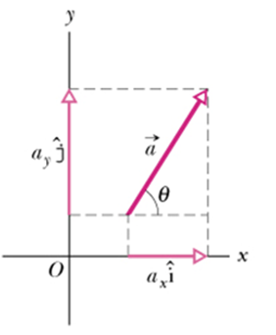

Slide 13
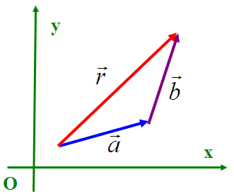
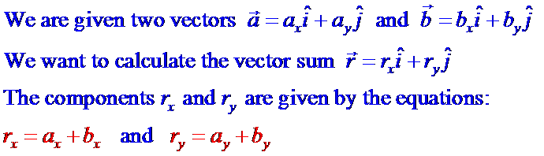
Adding Vectors by Components

Slide 14
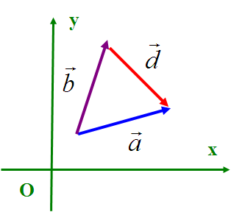
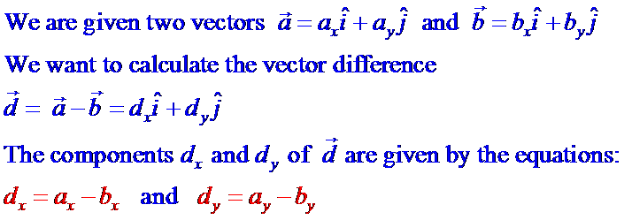
Subtracting Vectors by Components

Slide 15
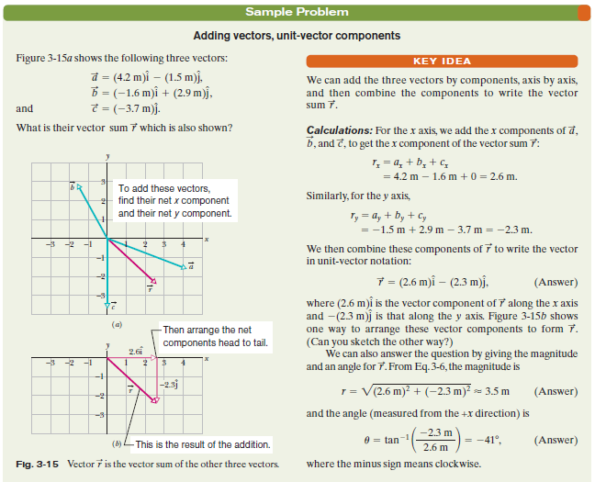

Slide 16
Muplication of Vectors
Muplication of Vectors by a Scalar
Scalar Product (Dot Product) of Vectors
Vector Product (Cross Product) of Vectors

Slide 17
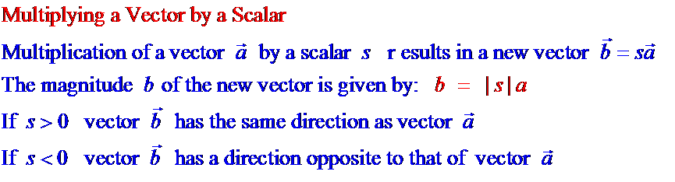

Slide 18
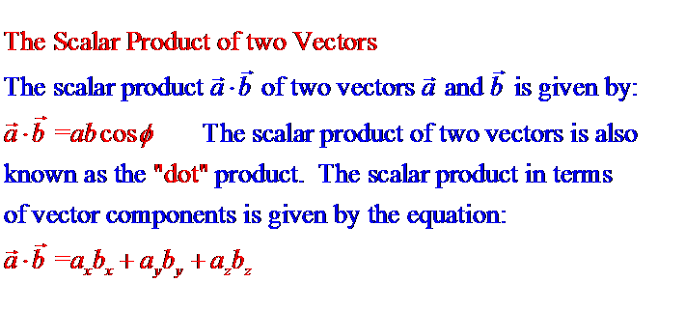
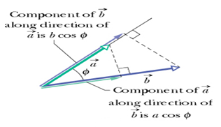


Slide 19
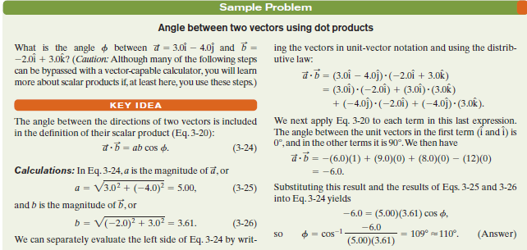

Slide 20
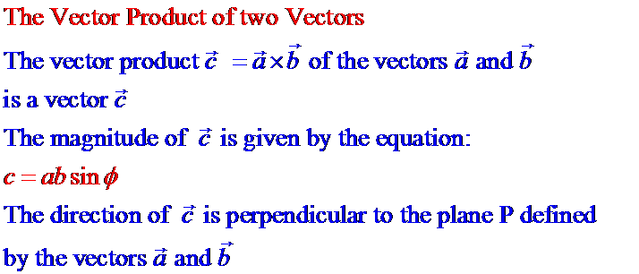

Slide 21
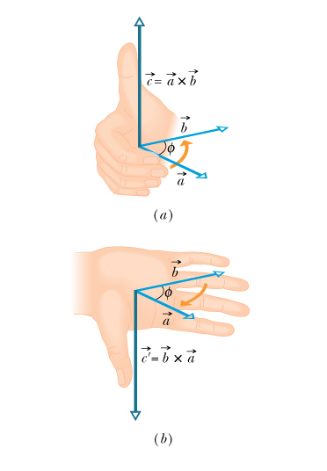
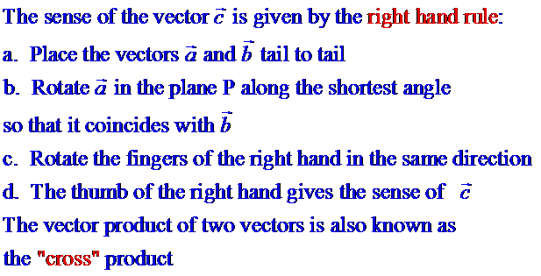

Slide 22
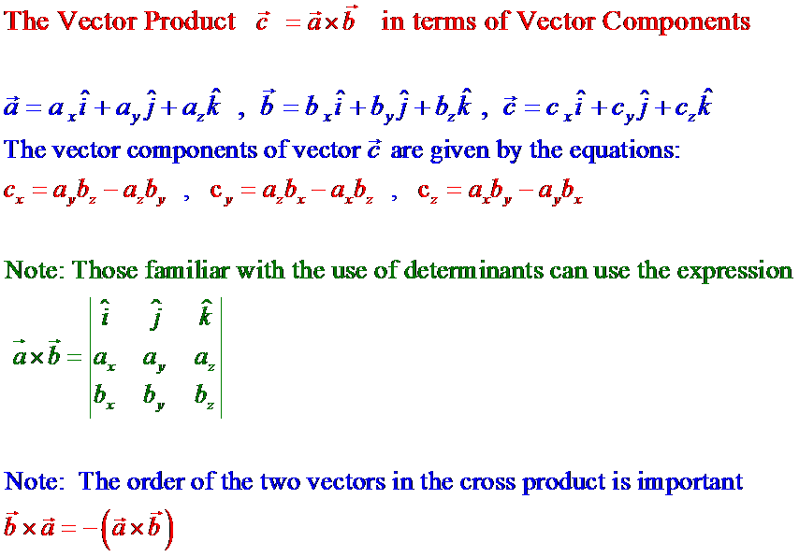

Slide 23
